Slide 1



Country Attractiveness For Outsourcing
Country Attractiveness
For Outsourcing
PRESENTED BY
GROUP 3
DIYA NARESH RAO
ERIC PRABOWO CUNDOMANIK
NEVIL BRUNO
PANKHURI DWIVEDI
PRIYANKA SHARMA
PRESENTED BY
GROUP 3
DIYA NARESH RAO
ERIC PRABOWO CUNDOMANIK
NEVIL BRUNO
PANKHURI DWIVEDI
PRIYANKA SHARMA

Slide 2
Introduction
Factors Influencing Choice of Country for Outsourcing
Clients and vendors take into account various factors when deciding geographical locations for their offshoring and offshore outsourcing strategies
Selecting a location is one of the major challenges an organization faces when making offshoring and outsourcing decisions
Cost
Skill
Market Potential
Risk Profile
Environment
Quality of Infrastructure

Slide 3
Cost Factor
1
Labor Cost
Average wages for skilled workers
2
Infrastructure Cost
Costs for rent, Telecom etc.
3
Corporate Tax
Tax Regulations and Incentives

Slide 4
Environment
Governance Support
Business Environment
Living Environment
Accessibility

Slide 5
Skill Factor
Skill Pool
Scalability
Size of local skilled resources and sector providing services.
Ability to supply sufficient skilled resources to handle the growing demand

Slide 6
Quality of Infrastructure
Telecom & IT
Transport
Power
Real Estate

Slide 7
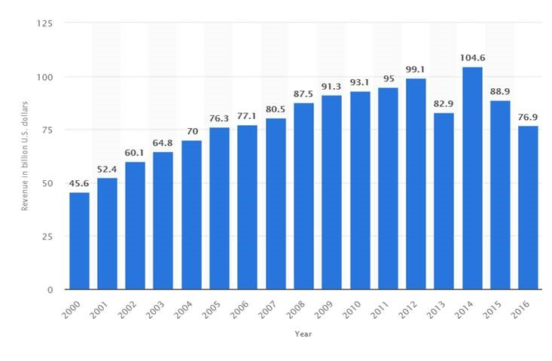
Market Potential
Access to nearby Markets
Attractiveness
Global market size of outsourced services from 2000 to 2016 (in billion U.S. dollars)
Source: https://www.statista.com/statistics/189788/global-outsourcing-market-size/

Slide 8

Security Issues
Disruptive Events
Risk Profile
Regulatory Risk
Macroeconomics Risk
Intellectual Property Risks

Slide 9
What attracts outsourcing sectors to these countries ?
Flexible Government Policy
Industry specific training program
Low cost of Living
Low Labor Cost
Reduced Land Costs
Quality of Workforce

Slide 10
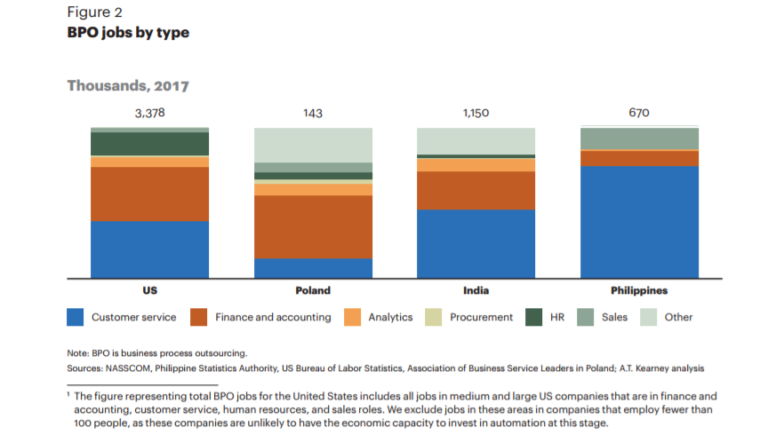
Source: 2017 A.T Kearney Global Services Index: The Widening Impact Of Automation

Slide 11

Outsourcing to China

Slide 12
China’s Competitive Advantage
1
Headquarter to many businesses
2
Outsourcing Market Growth Rate: 30% Annually
3
Cost reductions: 30% to 50%
4
Offers possibility to create a wide range of products and innovations & volumes for reasonable cost

Slide 13
Benefits of Outsourcing to China
Cheap Manual Labor
Skills
Affordable Products
Manpower - most important resource in any company, and is also one of the largest expenses.
By outsourcing to China you can reduce costs by between 30 and 80% depending on the labor intensity of the product. These outstanding rates will lower cost of production exponentially.
China is a reservoir of well-educated and highly committed technical graduates and engineers.
High-quality products for a mere fraction of costs in home country
Chinese factories provide discounted rates for bulk orders; therefore, more quantity for the same money.

Slide 14
Benefits of Outsourcing to China(Contd.)
Prompt Service
A wealth of Materials
Superior Results & Flexibility
Due to a huge population, manpower is abundant in China.
A high ratio of potential employees- faster production rate.
Diverse amount of parts and raw materials available
Most factories can customize a design they do not have in stock
Factories are very particular when it comes to quality- offer high-quality products and prompt delivery.
Contract manufacturers might produce goods for two or more companies, and even for competitors within the same industry.
More production- can respond to increased production requirements faster than the original manufacturer.

Slide 15
Data and Facts about China
Overtook Japan as the second-largest producer of cars and trucks after the United States, in 2006
Out of the world's five busiest ports in the world, three are in China.

Slide 16

Outsourcing to Philippines

Slide 17
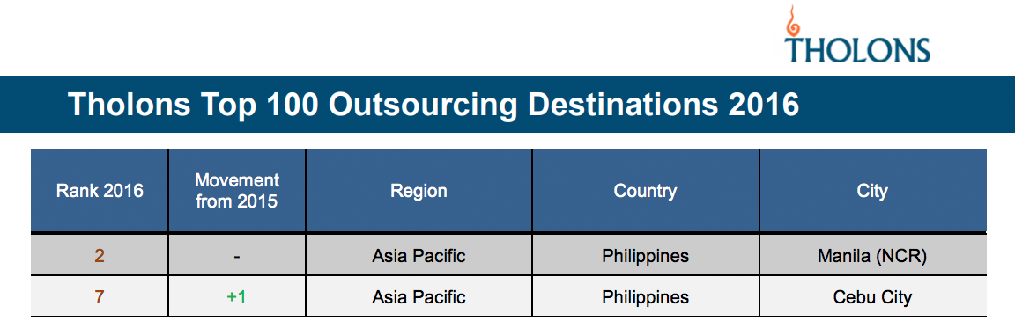
Philippines-Global Position

Slide 18

Philippines – WHY ?
Cultural Ties with US
+700,000 grads in 2016 – 30% is employable
4 out of 5 BPO in Philippine is Contact Center
English as second National Language
Contact Centers covers 12.6% of Global Markets
Good Telco Infrastructure – was US military based
$200-$500 monthly salary for tech./cust. support representatives

Slide 19

Philippines - Risk
Employee Attrition Rate Increasing
Call centers replacement with Automation
Competitive advantage reduction due to Taxation
Peso as worst performing currency in 2017

Slide 20
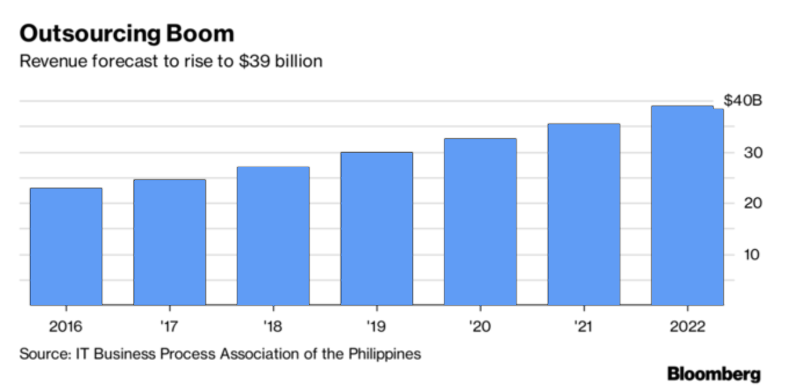
Philippines – Outsourcing Revenue Forecast
$39 billion by 2022

Slide 21

Outsourcing to India

Slide 22
India’s Competitive Advantage
LARGEST TECHNICAL AND PROFESSIONAL TALENT POOL IN THE WORLD
India remains unmatched when it comes to its vast pool of skilled and talented human resources. The country has a population of over 1.2 billion people and around 3.1 million graduates are added to the workforce each year.
INDIA OFFERS FLEXIBLE PRICING OPTIONS
The hourly cost of a developer in India can be negotiated down to as low as $15 per hour. This pricing flexibility allows companies the freedom and creativity in managing their budget and helps them reap large profits.
INDIA PROVIDES CONSISTENT HIGH QUALITY SERVICES
While the cost factor plays a huge role in outsourcing, the consistently high quality provided by Indian outsourcing firms has also enabled India to remain as the top outsourcing destination.
THE BEST IN INFRASTRUCTURE AND TECHNOLOGY
Modern India is well-developed and offers state-of-the-art telecom, ISP, and cellular networks in all major cities and towns.

Slide 23
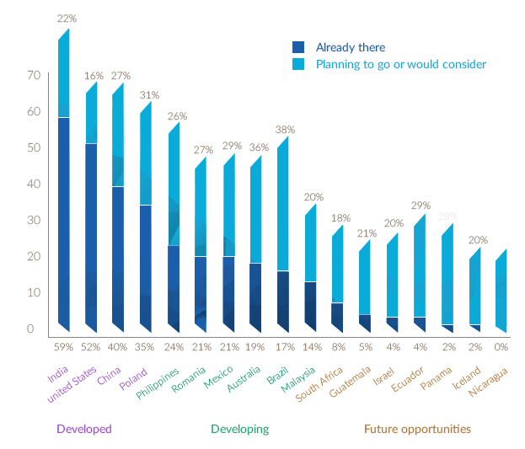
India as a Global Outsourcing Destination
A report by PwC in 2014 highlighted :
The Indian IT/ITeS industry has a strong and established Customer Footprint in North America and Europe.
Industry coverage is extensive, with clients from Manufacturing, Telecom/Hi‐tech, Retail, BFSI, Healthcare, travel, transportation and media.
According to a recent Deloite survey, 59% of businesses that were interviewed are already outsourcing to India, with an additional 22% planning to go or considering it.
Source : www.backofficepro.com/white-paper/outsourcing-to-india/

Slide 24
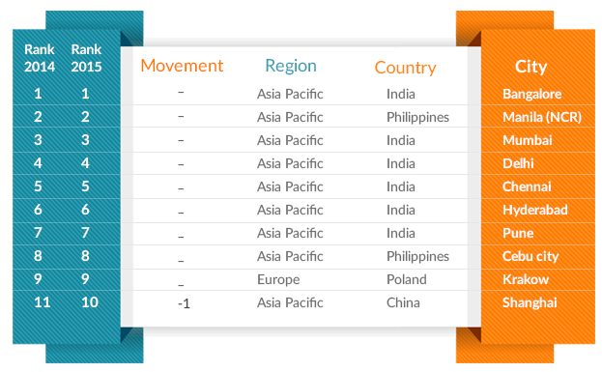
India maintains Top rank in Outsourcing Choice
India is the leader in outsourcing worldwide, with 6 out of the top 10 outsourcing destinations, according to Tholons 2015 Top 100 Outsourcing Destinations.
100 million English speaking people – the second largest in the world after USA.
Over 3 million IT employees with the outsourcing industry and indirect employment to 10 million people
Source : www.backofficepro.com/white-paper/outsourcing-to-india/

Slide 25
Challenges to the Indian Outsourcing Market
The Indian outsourcing industry is a major economic sector in the country. Challenges to the sector have been acknowledged by major market research companies, as well as the government:
Non‐existence of social security laws needed for checking the background of employees working in BPOs and call centers
01
Largely fragmented industry.
02
03
Need of higher level of control, confidentiality and enhanced risk management.
04
Cut‐throat competition as well as severe shortages of trained and skilled manpower.
Automation and Standardization
06
Technological requirements are growing even more rapidly, the country need to keep the pace with the infrastructure
05
Source : www.backofficepro.com/white-paper/outsourcing-to-india/

Slide 26
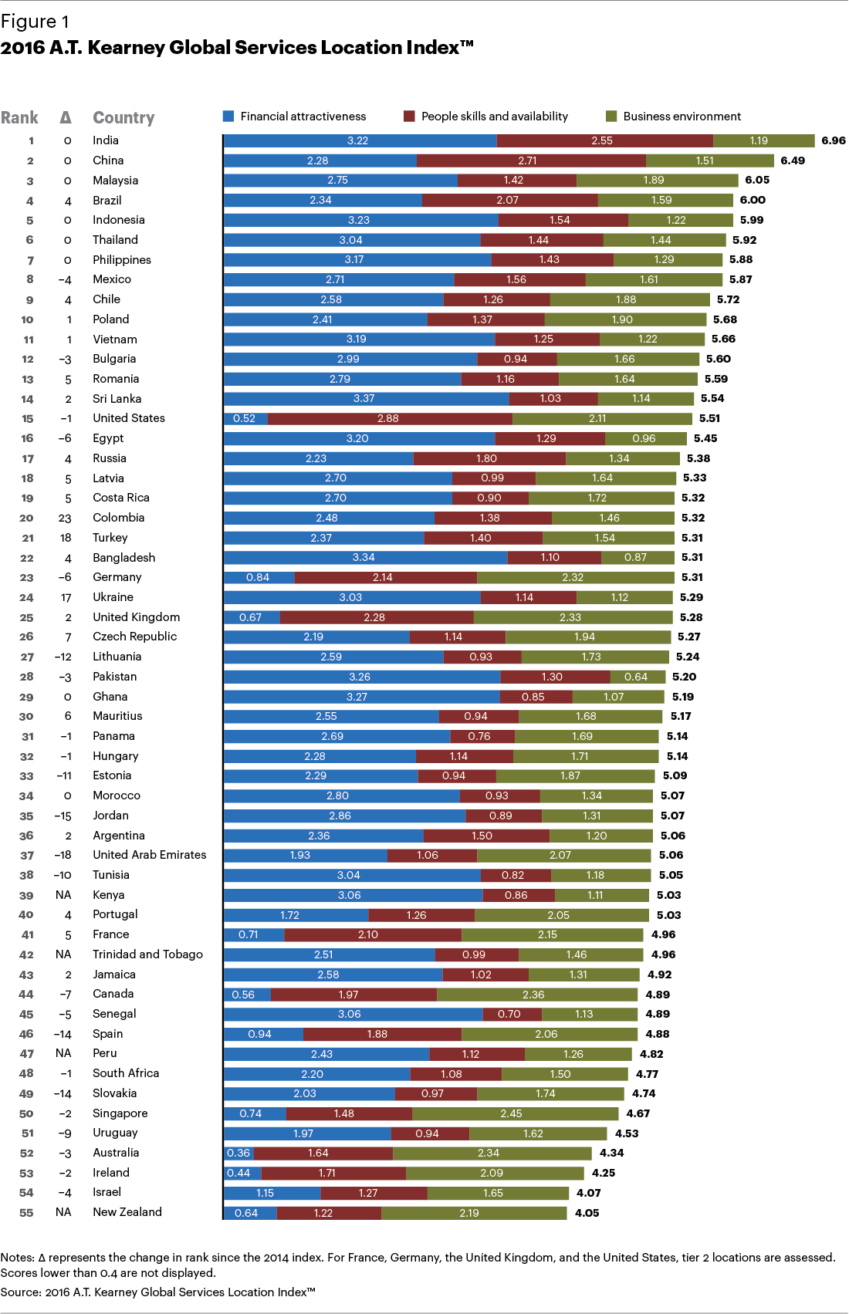
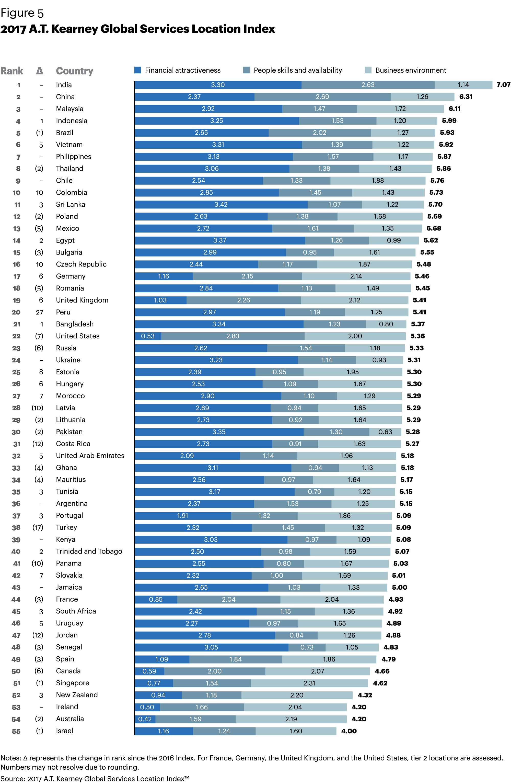

Slide 27
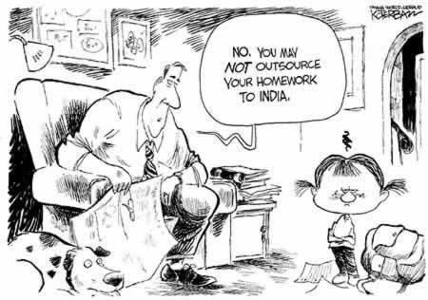
THANK YOU!

Slide 28
References
https://www.atkearney.com/documents/20152/793366/The+Widening+Impact+of+Automation.pdf/42b06cf4-e5f9-d8ec-a30c-a82dd26d4953
https://www.outsource2india.com/why_india/why_india.asp
https://www.aseanbriefing.com/news/2017/04/17/business-process-outsourcing-philippines.html
https://www.statista.com/statistics/189788/global-outsourcing-market-size/
The Competitive Advantage https://www.forbes.com/sites/allbusiness/2014/02/07/manufacturing-in-china-can-give-your-business-the-competitive-advantage/#75648e5d2774
The Benefits of Outsourcing to China http://baysourceglobal.com/benefits-of-outsourcing-manufacturing-to-china/
China - ‘The Workshop of the World’ http://www.rgs.org/OurWork/Schools/Teaching+resources/Key+Stage+3+resources/China+Today/Made+in+China.htm
www.backofficepro.com/white-paper/outsourcing-to-india
https://www.outsource2india.com/why_india/why_india.asp
https://www.atkearney.com/digital-transformation/article?/a/2016-global-services-location-index-

Slide 29
References(Cont.)
https://www.atkearney.com/documents/20152/793366/The+Widening+Impact+of+Automation.pdf/42b06cf4-e5f9-d8ec-a30c-a82dd26d4953
Chapter 3: The Handbook of Global Outsourcing and Offshoring 3rd edition. Authors: Oshri, Ilan, Kotlarsky, Julia, Willcocks, Leslie P.
http://www.tholons.com/TholonsTop100/pdf/Tholons_Top_100_2016_Executive_Summary_and_Rankings.pdf
http://www.manilatimes.net/fresh-graduates-to-join-ranks-of-unemployed/251068/
Handbook for Global Outsourcing and Offshoring (page 31)
Handbook for Global Outsourcing and Offshoring (page 40)
https://www.reuters.com/article/us-philippines-economy-outsourcing/rise-of-the-machines-philippine-outsourcing-industry-braces-for-ai-idUSKBN1D90BH
https://www.aseanbriefing.com/news/2017/04/17/business-process-outsourcing-philippines.html
https://www.cnbc.com/2017/08/14/the-philippines-peso-asias-worst-performing-currency-may-get-even-weaker-central-bank-governor-nestor-espenilla-responds.html
https://www.telusinternational.com/articles/philippines-outsourcing/
https://www.bloomberg.com/news/articles/2017-07-31/philippines-vows-to-defend-outsourcing-empire-as-china-rises

